Slide 1
Mathematical Methods for Scientific Computing
Multivariable Calculus
Stephen Millmore
Laboratory for Scientific Computing,
University of Cambridge

Slide 2
Outline
1. Multivariable calculus
2. Thermodynamics and partial derivatives
3. Derivatives and integrals

Slide 3

Multivariable calculus

Slide 4
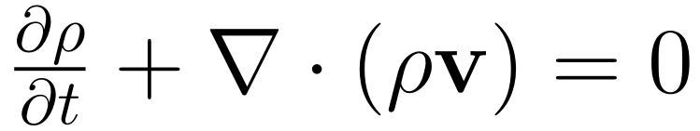
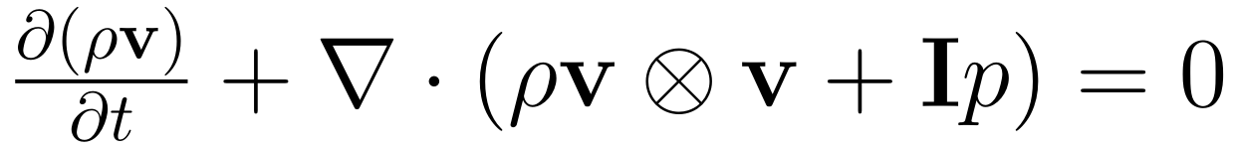
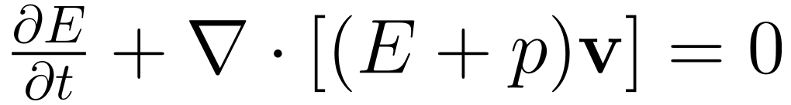
Coupled systems of equations
Scientific computing is a valuable tool for complex physical problems
Such problems rarely have a single, well-behaved variable, but instead we must consider complex, coupled multivariable systems
And coincidentally, my favourite equations, the compressible Euler equations are just such a system
These are coupled equations – we cannot split them into three individual equations
They also have rather more than three variables it seems

Slide 5
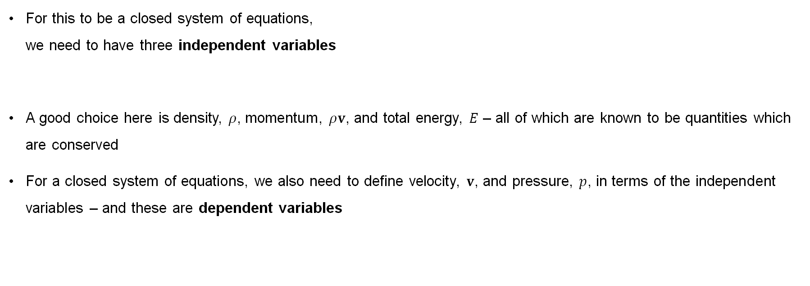
Independent and dependent variables
For this to be a closed system of equations,
we need to have three independent variables
A good choice here is density, $ρ$, momentum, $ρv$, and total energy, $E$ – all of which are known to be quantities which are conserved
For a closed system of equations, we also need to define velocity, $v$, and pressure, $p$, in terms of the independent variables – and these are dependent variables

Slide 6
Coupled systems of equations
The choice of independent variables is not unique – as long as the system is closed by three variables, we can label these as the independent variables
For some applications, the actual choice of independent variables doesn't really matter – we just need to know the equations can be solved
However, if we want to start manipulating our equations, and performing additional calculus, we need to be certain we are consistent with how variables are treated

Slide 7
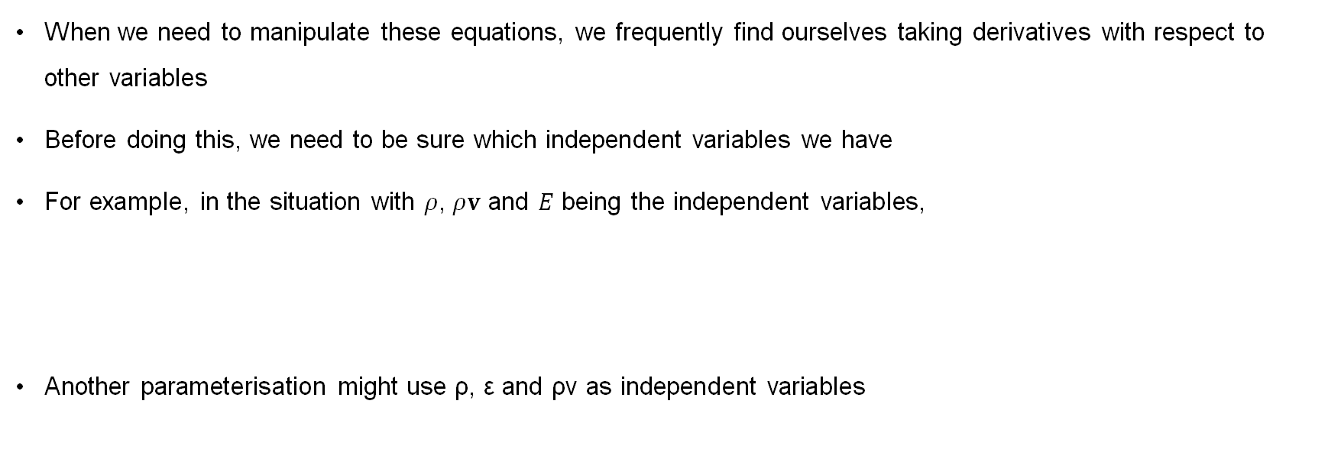
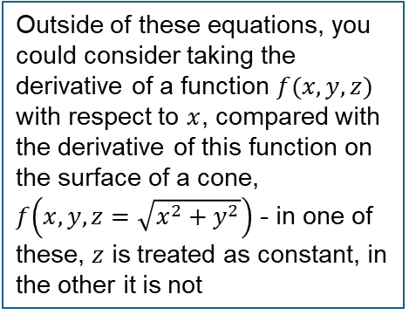
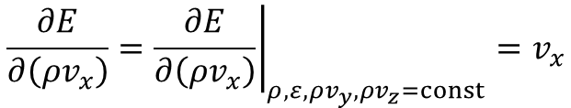
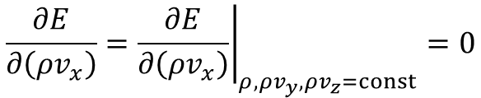
Closure and derivatives
When we need to manipulate these equations, we frequently find ourselves taking derivatives with respect to other variables
Before doing this, we need to be sure which independent variables we have
For example, in the situation with $ρ$, $ρv$ and $E$ being the independent variables,
Another parameterisation might use ρ, ε and ρv as independent variables
Outside of these equations, you could consider taking the derivative of a function $f(x,y,z)$ with respect to $x$, compared with the derivative of this function on the surface of a cone,
$f\left(x,y,z=\sqrt{x^{2}+y^{2}}\right)$ - in one of these, $z$ is treated as constant, in the other it is not
$$\frac{∂E}{∂\left(ρv_{x}\right)}={\left.\frac{∂E}{∂\left(ρv_{x}\right)}\right|}_{ρ,ρv_{y},ρv_{z}=const}=0$$
$$\frac{∂E}{∂\left(ρv_{x}\right)}={\left.\frac{∂E}{∂\left(ρv_{x}\right)}\right|}_{ρ,ε,ρv_{y},ρv_{z}=const}=v_{x}$$

Slide 8
Partial derivatives

Slide 9
Switching between multiple variables
When it comes to physical systems, there are a large number of variables which can be used to describe properties, e.g. pressure, temperature, volume, density, number density, entropy, energy, momentum, velocity, enthalpy and heat (not an exhaustive list)
These are not all independent variables, and often we will be able to write one in terms of one or more of the other variables
For example, the ideal gas law can be expressed as
More generally, we want equations which don’t assume a form for these these relationships, in which case, we know that we could write
When analysing properties of a material, we may find we need to take derivatives with respect to variables we did not use in our formulation, and for this we need the multivariable chain rule

Slide 10
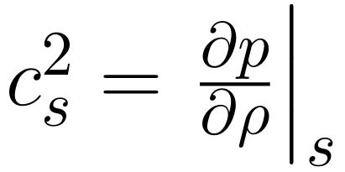
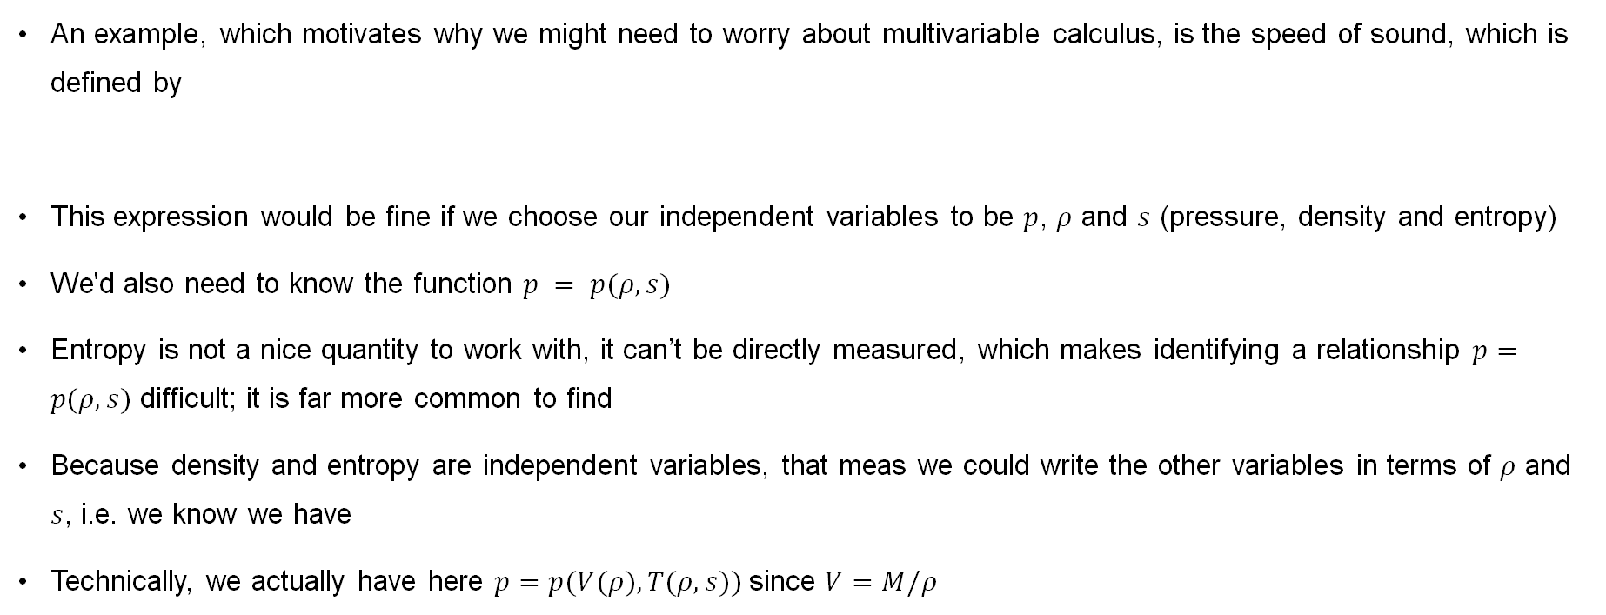
Speed of sound
An example, which motivates why we might need to worry about multivariable calculus, is the speed of sound, which is defined by
This expression would be fine if we choose our independent variables to be $p$, $ρ$ and $s$ (pressure, density and entropy)
We'd also need to know the function $p = p(ρ,s)$
Entropy is not a nice quantity to work with, it can’t be directly measured, which makes identifying a relationship $p=p(ρ, s)$ difficult; it is far more common to find
Because density and entropy are independent variables, that meas we could write the other variables in terms of $ρ$ and $s$, i.e. we know we have
Technically, we actually have here $p=p(V(ρ),T(ρ,s))$since $V=M/ρ$

Slide 11
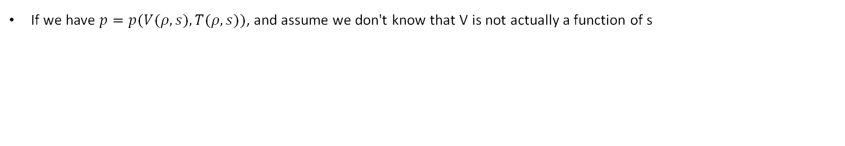
Multivariable chain rule
If we have $p=p(V(ρ,s),T(ρ,s))$, and assume we don't know that V is not actually a function of s

Slide 12
Multivariable chain rule

Slide 13
Multivariable chain rule

Slide 14
Multivariable chain rule

Slide 15
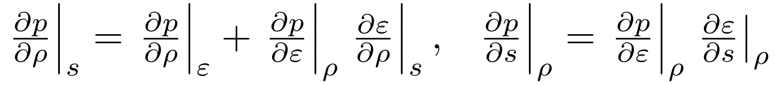
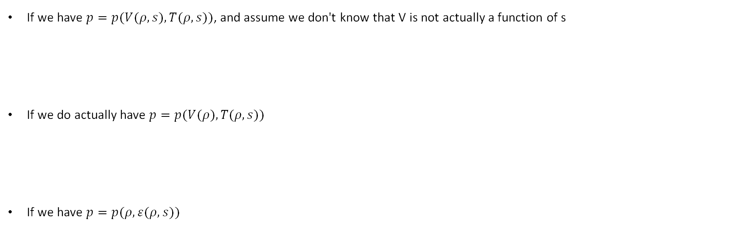
Multivariable chain rule
If we have $p=p(V(ρ,s),T(ρ,s))$, and assume we don't know that V is not actually a function of s
If we do actually have $p=p(V(ρ),T(ρ,s))$
If we have $p=p(ρ,ε(ρ,s))$

Slide 16
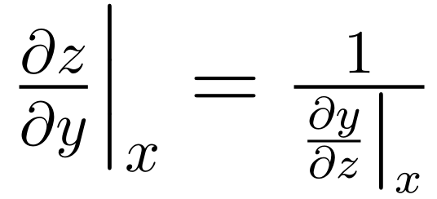
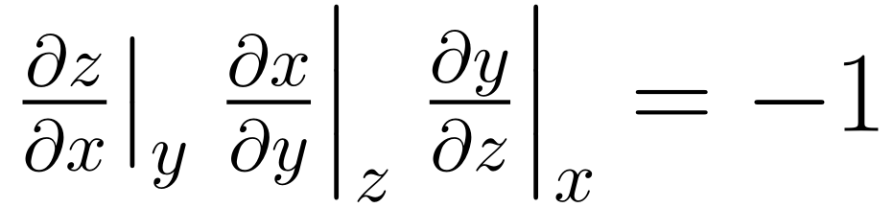
Reciprocal and cyclic rules
We are about to see that we may need to manipulate the partial derivative expressions to make them easier to compute
To help, we can derive useful relationships
The reciprocal rule
The cyclic rule

Slide 17
Cyclic and reciprocal rules

Slide 18
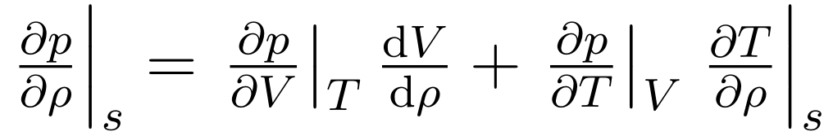
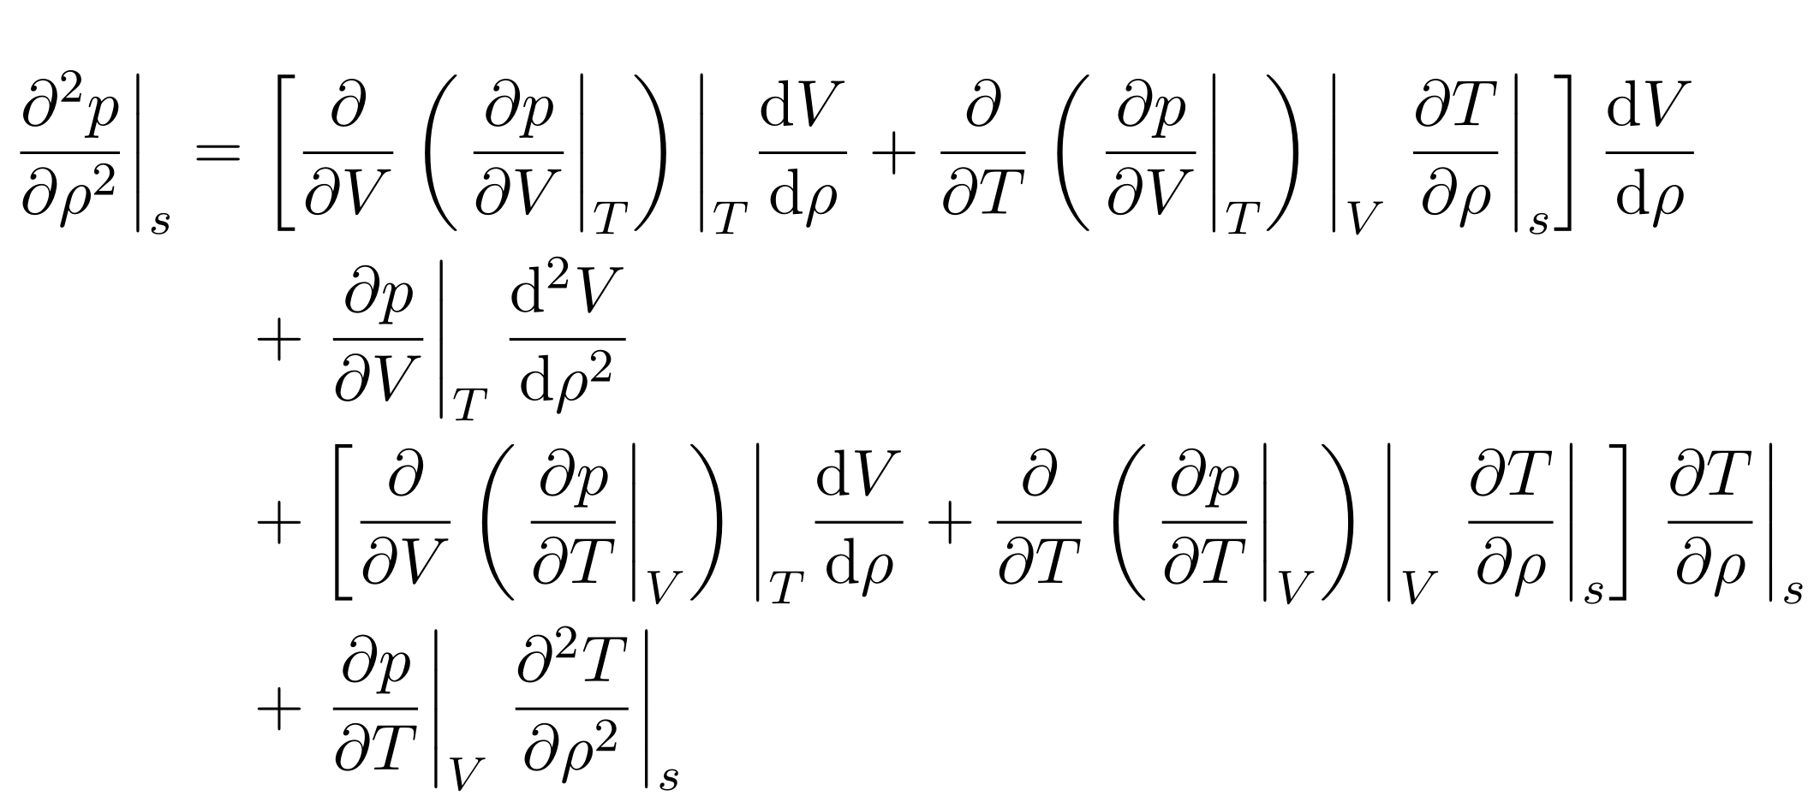
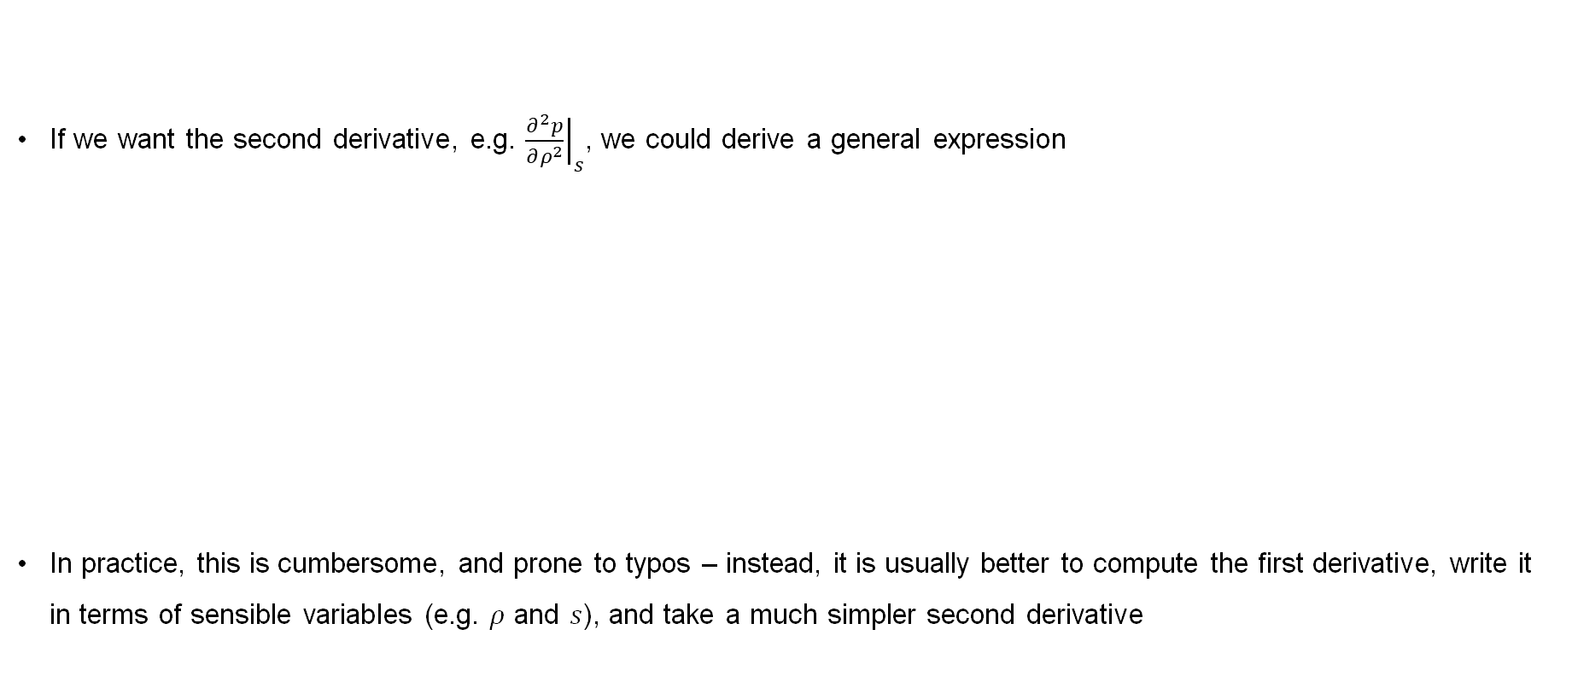
Higher derivatives
If we want the second derivative, e.g. ${\left.\frac{∂^{2}p}{∂ρ^{2}}\right|}_{s}$, we could derive a general expression
In practice, this is cumbersome, and prone to typos – instead, it is usually better to compute the first derivative, write it in terms of sensible variables (e.g. $ρ$ and $s$), and take a much simpler second derivative

Slide 19
Higher derivatives

Slide 20
Higher derivatives

Slide 21
Higher derivatives

Slide 22
Higher derivatives

Slide 23

Thermodynamics and partial derivatives

Slide 24
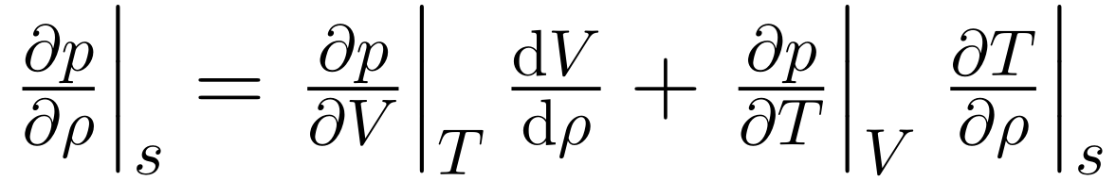
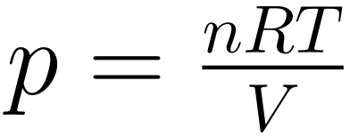
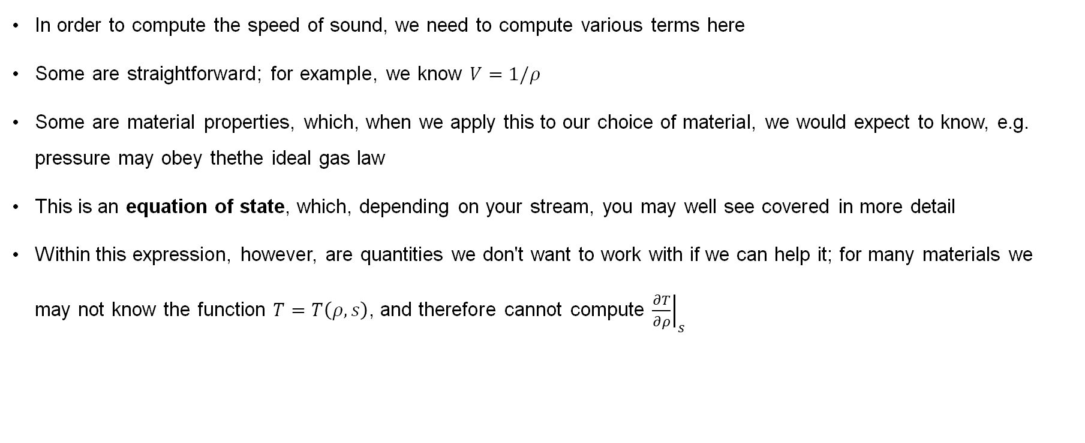
Another look at the speed of sound
In order to compute the speed of sound, we need to compute various terms here
Some are straightforward; for example, we know $V=1/ρ$
Some are material properties, which, when we apply this to our choice of material, we would expect to know, e.g. pressure may obey thethe ideal gas law
This is an equation of state, which, depending on your stream, you may well see covered in more detail
Within this expression, however, are quantities we don't want to work with if we can help it; for many materials we may not know the function $T=T\left(ρ,s\right)$, and therefore cannot compute ${\left.\frac{∂T}{∂ρ}\right|}_{s}$

Slide 25
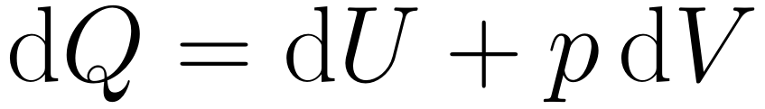
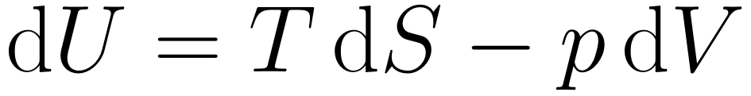
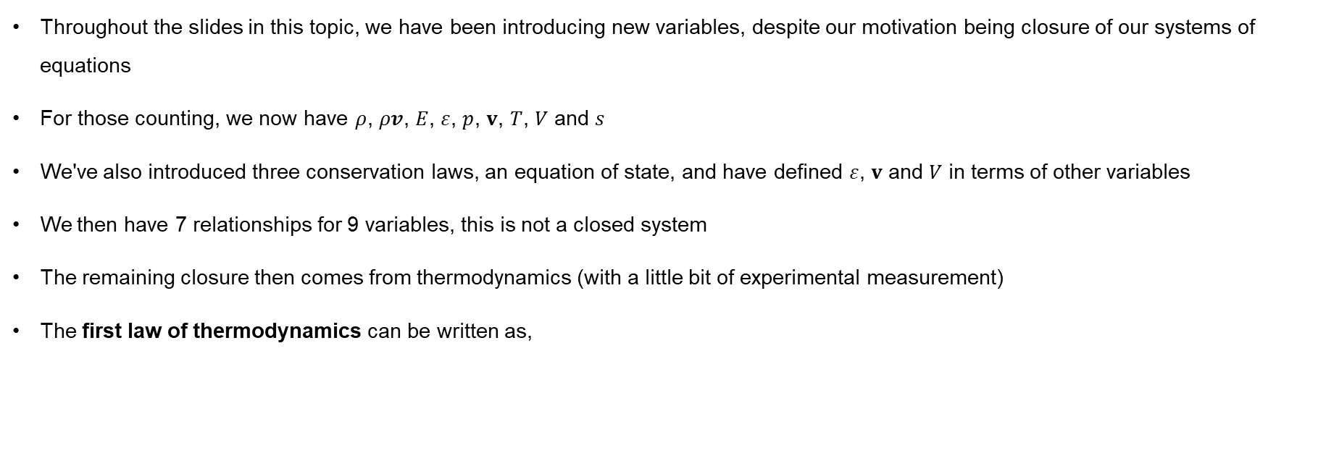
Thermodynamics and closure
Throughout the slides in this topic, we have been introducing new variables, despite our motivation being closure of our systems of equations
For those counting, we now have $ρ$, $ρv$, $E$, $ε$, $p$, $v$, $T$, $V$ and $s$
We've also introduced three conservation laws, an equation of state, and have defined $ε$, $v$ and $V$ in terms of other variables
We then have 7 relationships for 9 variables, this is not a closed system
The remaining closure then comes from thermodynamics (with a little bit of experimental measurement)
The first law of thermodynamics can be written as,
or

Slide 26
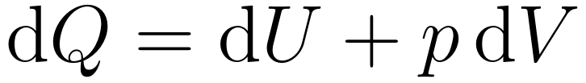
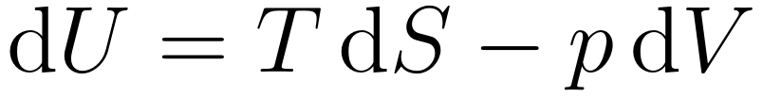
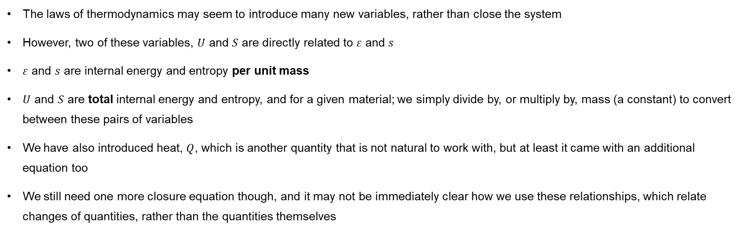
Thermodynamic quantities
The laws of thermodynamics may seem to introduce many new variables, rather than close the system
However, two of these variables, $U$ and $S$ are directly related to $ε$ and $s$
$ε$ and $s$ are internal energy and entropy per unit mass
$U$ and $S$ are total internal energy and entropy, and for a given material; we simply divide by, or multiply by, mass (a constant) to convert between these pairs of variables
We have also introduced heat, $Q$, which is another quantity that is not natural to work with, but at least it came with an additional equation too
We still need one more closure equation though, and it may not be immediately clear how we use these relationships, which relate changes of quantities, rather than the quantities themselves

Slide 27
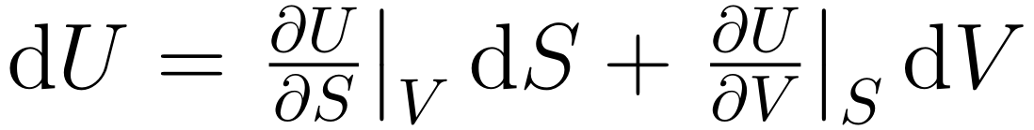
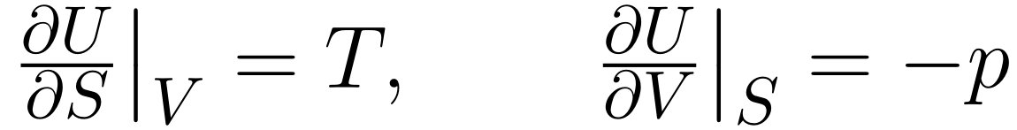
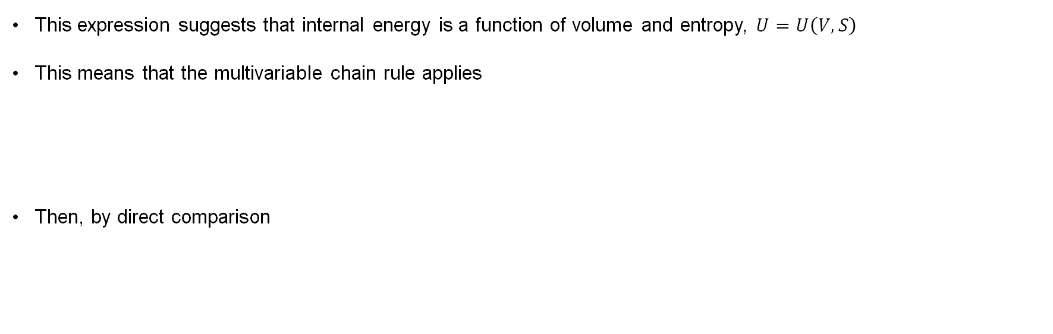
Maxwell's relations
This expression suggests that internal energy is a function of volume and entropy, $U=U\left(V,S\right)$
This means that the multivariable chain rule applies
Then, by direct comparison

Slide 28
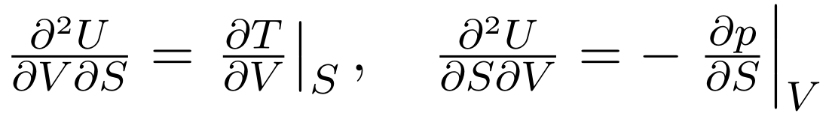
Maxwell's relations
We can then take additional derivatives of these terms
This is one of Maxwell's relations, others can be derived from:
    Helmholtz free energy
    Enthalpy
    Gibbs free energy

Slide 29
Helmholtz free energy

Slide 30
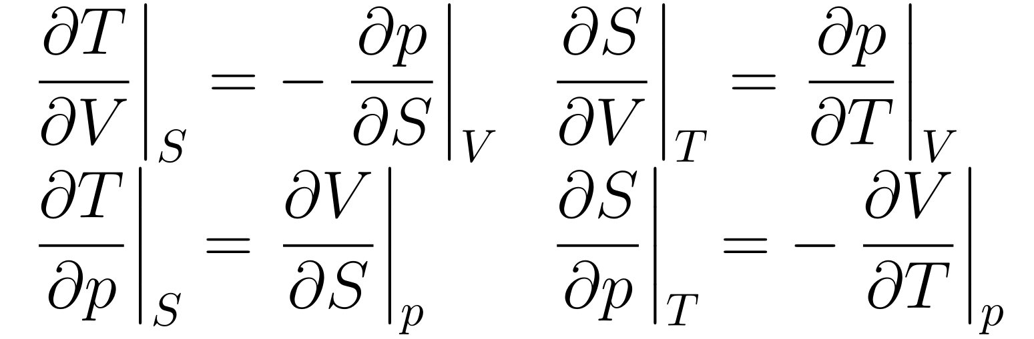
Maxwell's relations
By following the steps of matching chain rule quantities with each of these relationships, and then taking a second derivative, we obtain all of Maxwell's relations
These relationships allow us to rewrite terms where we don't like the variable we are dealing with
They are particularly useful for avoiding entropy, either as the variable we are keeping constant, or as one of the variables in a partial derivative
In order to fully close our system, we still need one more relationship

Slide 31
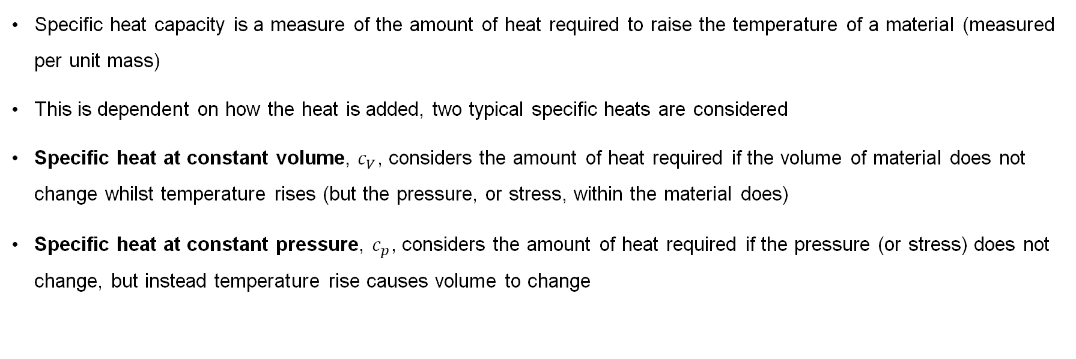
Specific heat capacity
Specific heat capacity is a measure of the amount of heat required to raise the temperature of a material (measured per unit mass)
This is dependent on how the heat is added, two typical specific heats are considered
Specific heat at constant volume, $c_{V}$, considers the amount of heat required if the volume of material does not change whilst temperature rises (but the pressure, or stress, within the material does)
Specific heat at constant pressure, $c_{p}$, considers the amount of heat required if the pressure (or stress) does not change, but instead temperature rise causes volume to change

Slide 32
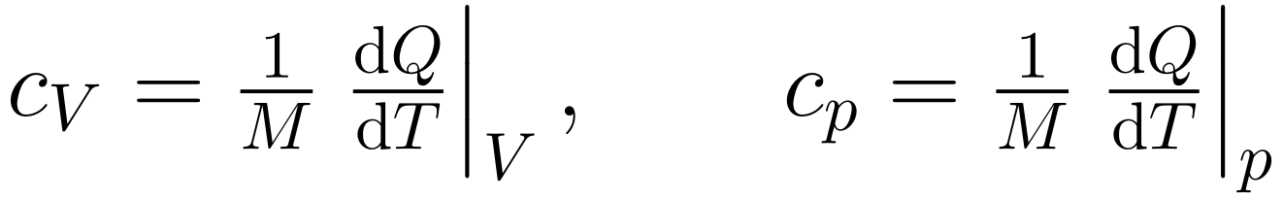
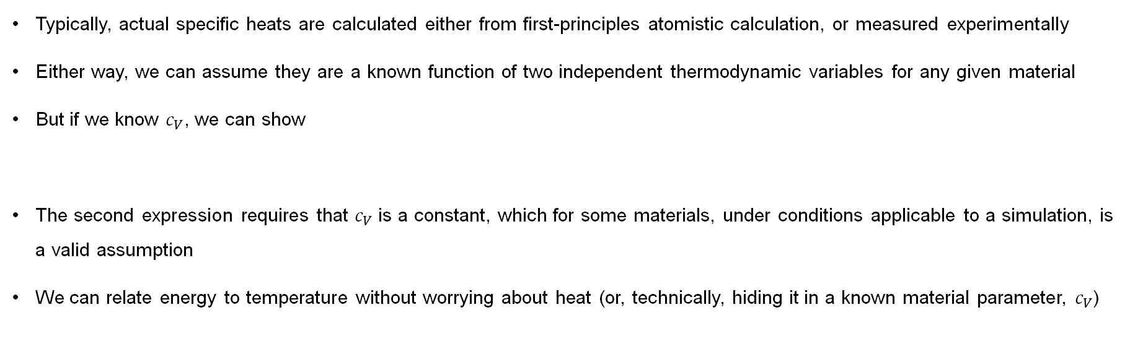
Specific heat capacity
Typically, actual specific heats are calculated either from first-principles atomistic calculation, or measured experimentally
Either way, we can assume they are a known function of two independent thermodynamic variables for any given material
But if we know $c_{V}$, we can show
The second expression requires that $c_{V}$ is a constant, which for some materials, under conditions applicable to a simulation, is a valid assumption
We can relate energy to temperature without worrying about heat (or, technically, hiding it in a known material parameter, $c_{V}$)

Slide 33
Internal energy

Slide 34
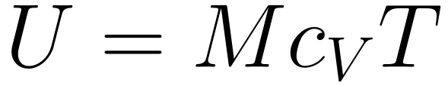
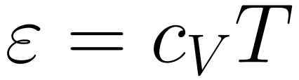
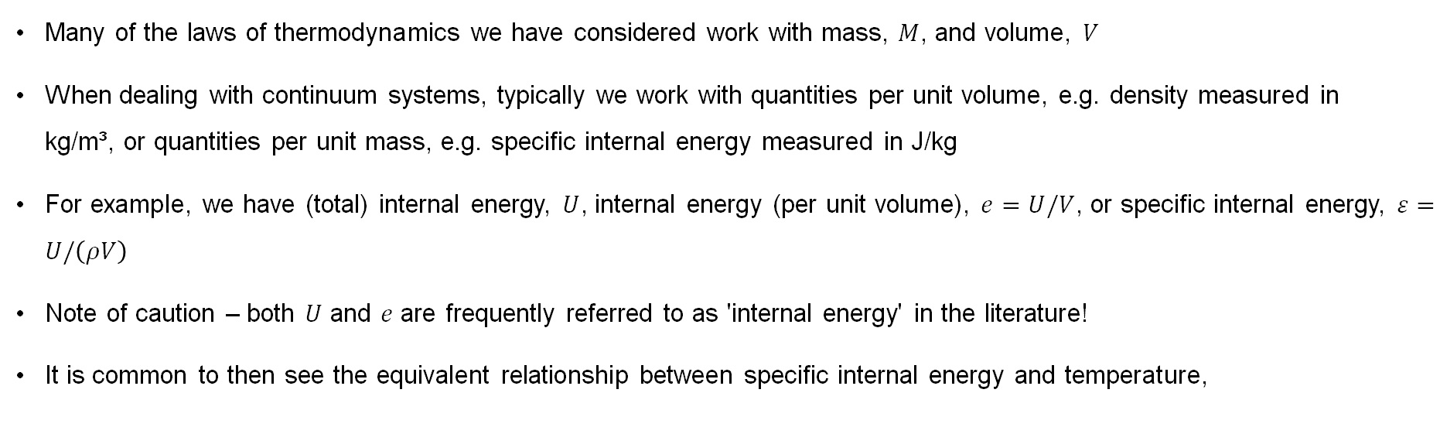
Volumetric quantities
Many of the laws of thermodynamics we have considered work with mass, $M$, and volume, $V$
When dealing with continuum systems, typically we work with quantities per unit volume, e.g. density measured in kg/m³, or quantities per unit mass, e.g. specific internal energy measured in J/kg
For example, we have (total) internal energy, $U$, internal energy (per unit volume), $e=U/V$, or specific internal energy, $ε=U/\left(ρV\right)$
Note of caution – both $U$ and $e$ are frequently referred to as 'internal energy' in the literature!
It is common to then see the equivalent relationship between specific internal energy and temperature,

Slide 35
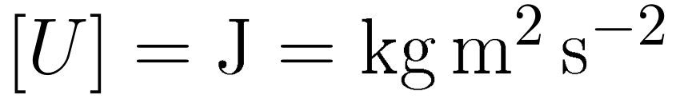
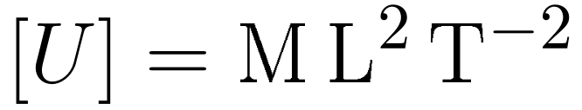
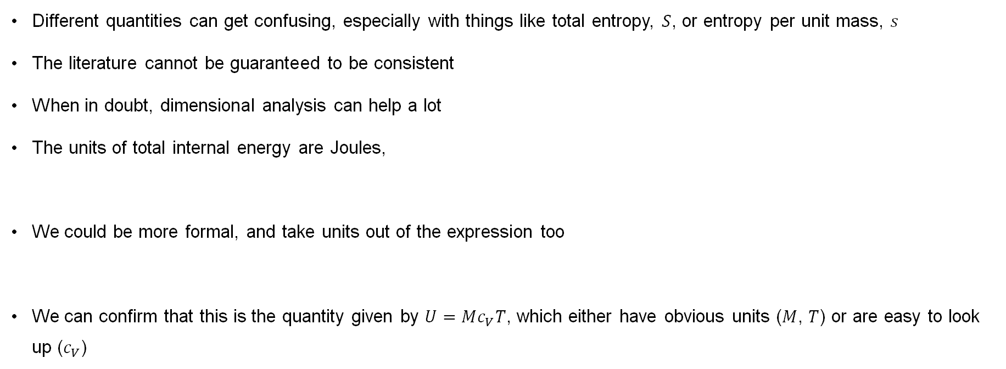
Dimensional analysis
Different quantities can get confusing, especially with things like total entropy, $S$, or entropy per unit mass, $s$
The literature cannot be guaranteed to be consistent
When in doubt, dimensional analysis can help a lot
The units of total internal energy are Joules,
We could be more formal, and take units out of the expression too
We can confirm that this is the quantity given by $U=Mc_{V}T$, which either have obvious units ($M$, $T$) or are easy to look up ($c_{V}$)

Slide 36
Dimensional analysis

Slide 37
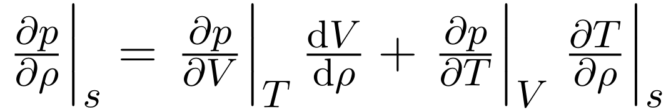
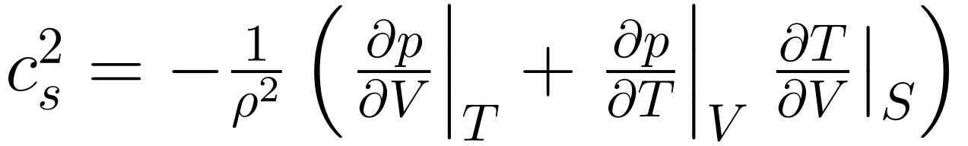
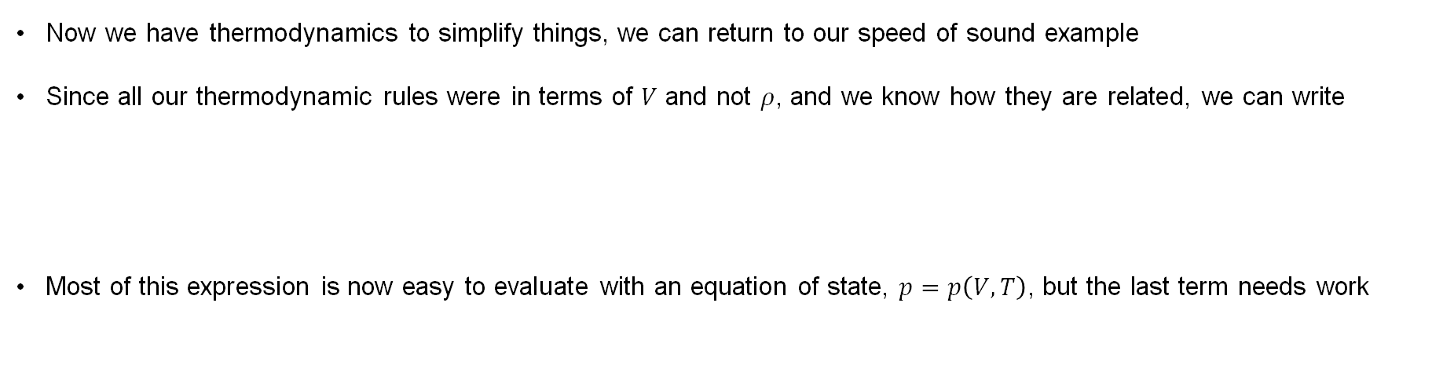
Back to the speed of sound (again)
Now we have thermodynamics to simplify things, we can return to our speed of sound example
Since all our thermodynamic rules were in terms of $V$ and not $ρ$, and we know how they are related, we can write
Most of this expression is now easy to evaluate with an equation of state, $p=p\left(V,T\right)$, but the last term needs work

Slide 38
Speed of sound

Slide 39
Speed of sound

Slide 40
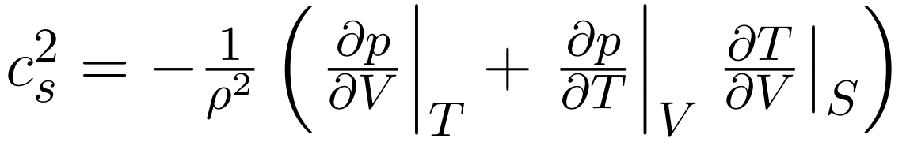
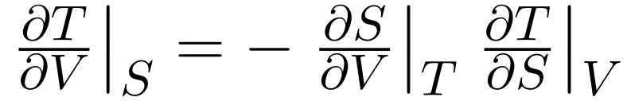
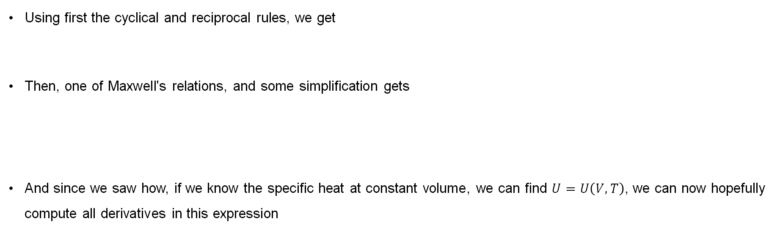
Back to the speed of sound (again)
Using first the cyclical and reciprocal rules, we get
Then, one of Maxwell's relations, and some simplification gets
And since we saw how, if we know the specific heat at constant volume, we can find $U=U\left(V,T\right)$, we can now hopefully compute all derivatives in this expression

Slide 41
Speed of sound

Slide 42
Speed of sound

Slide 43
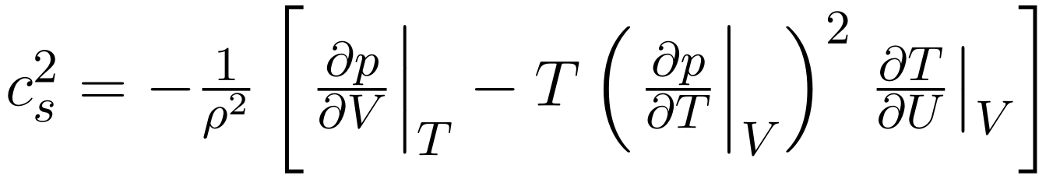
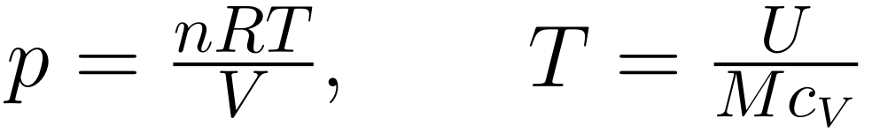
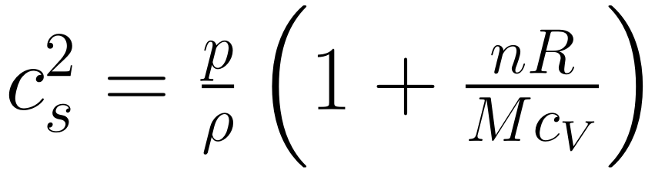

Example for the speed of sound
The eventual expression for the speed of sound reads
If we use the ideal gas law (which has constant $c_{V}$), we have
This gives a speed of sound

Slide 44

Derivatives and integrals

Slide 45



Derivatives and integrals
An interesting application of multivariable calculus is when you want to take the integral of a function with respect to one variable, and a derivative with respect to the other
For example, consider
This could represent the total energy at time $t$ within our domain $x∈\left[a,b\right]$, and it could be useful to compute $\frac{dG}{dt}$
In this case, this would be trivial, compute the integral first, and then the derivative. But what if the domain was not fixed, and we had

Slide 46


Why might we have this?
One possible application of this is a piston; fuel is compressed by the piston, hence the limits of the volume inside the piston change
Additionally, although it is a (hopefully) closed domain, the piston exerts pressure, and this can cause fuel to ignite, hence energy is not constant in this domain
In order to understand the behaviour of this piston, it is reasonable to assume we might be interested in $\frac{dG}{dt}$, where $G$ is the total energy within the fuel, and we want to know how this changes (note – energy within the fuel is not conserved, because the combustion of fuel generates kinetic energy in the piston, which removes it from the domain)
How would we compute this?

Slide 47

Leibniz's integral rule
If we're lucky, we can compute the integral first and then take the derivative – but a more general approach exists
Leibniz’s integral rule gives
This lets us reverse the order of operations – differentiating first, then integrating where necessary
Sometimes this will be easier to compute, and a direct application (relevant to the continuum stream) is behaviour across a shock wave

Slide 48
Leibniz integral rule

Slide 49
Leibniz integral rule

Slide 50
Leibniz integral rule

